Slide 1
Comparison of Meta-heuristic Optimizations for SPMP with impacts of Team Efficiency
Team 12
Jaehoon Choi
Chansu Park
Phan Duy Loc
Eunji Lee

Slide 2
1. Introduction

Slide 3

T- SPMP
Team efficiency matters
T-SPMP is an extended version of SPMP, which takes team efficiency into account
i.e. certain combinations of employees can increase or decrease task’s duration
Example: A & B may work more efficiently if they have worked with each other before.

Slide 4
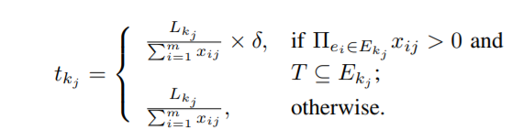
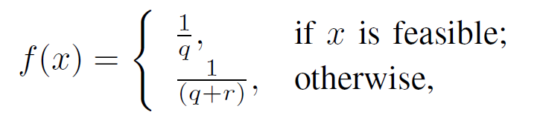
Optimization and constraints
Minimize: Project’s Duration & Cost
Constraints:
Every task is assigned at least 1 employee
Union of skills of employees assigned to task T contains all T’s required skills
Overwork is not allowed

Slide 5
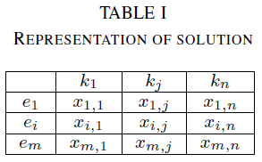
Input and Output of T-SPMP
Input : list of tasks, list of employees, TPG
Output format:

Slide 6
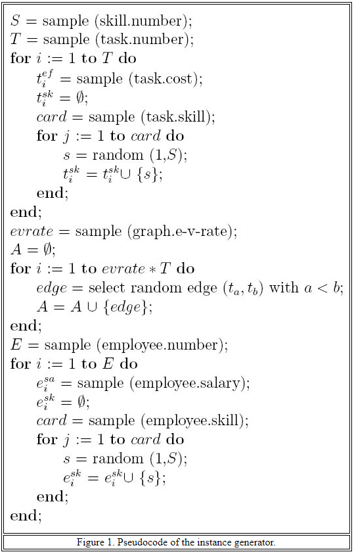
How we generate dataset?
We generate dataset using the algorithm introduced in the following paper
E. Alba and J. F. Chicano, “An instance generator for the project scheduling problem,” University of Mlaga, Tech. Rep., 2005.
The authors claim that the algorithm produces a “ realistic” dataset for project scheduling problem
For our dataset, we choose to generate 5 to 10 tasks, 7 to 10 employees

Slide 7
Team Efficiency Calculations
Each employee is assigned with a team efficiency array containing his efficiency with each other employee
Team efficiency TE = Σ (efficiency_{i, j} * #((skill_{i} ∪ skill_{j}) ∩ skill_{task})) / skill_{task}
Normalize TE
To calculate the duration of a task considering team efficiency

Slide 8
2. Algorithm Implementations

Slide 9
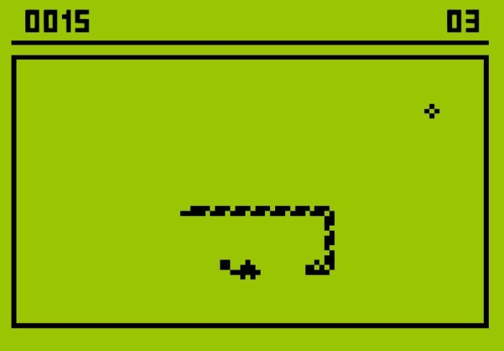
Tabu Search
Objective: to constrain/penalize an embedded heuristic from returning to recently visited areas of search space (a.k.a. cycling)
This ensures that new regions of a problem solution space will be investigated
Tabu List = a list of solutions that must be avoided
Similar to a snake game but the length of the snake is fixed

Slide 10
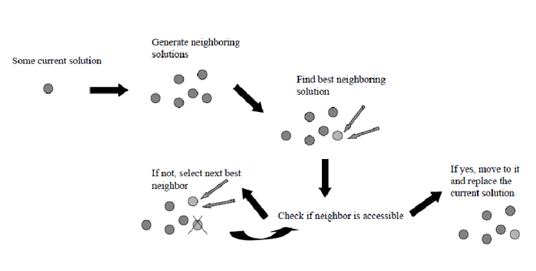
Algorithm Overview
+ add it to the tabu list & update best solution found if possible
(is neighbor in tabu list?)

Slide 11



Adaptation to Solve Human Resource Allocation (1/2)
Fitness function? How to know which solution is the best?
Apply and use the fitness function introduced by Nanlin & Xin (CEC14)
How to generate neighbors?
For each entry in allocation matrix, change the value by a certain dist
Example: add/minus 0.1 to the first entry generates 2 new neighbors

Slide 12
Adaptation to Solve Human Resource Allocation (2/2)
Should dist used to generate neighbors be fixed?
We tried 2 different ways to set value of dist
Fixed value = 0.1
Randomized value at each iteration {0.1, 0.2, …, 0.9}
What should be the size of tabu list?
Our experiment compares the technique’s performance within the first 1000 iterations so we chose the tabu list size to be 25, 50 or 100
However, there were no difference in the results so in comparison we will only show data for tabu list size 50

Slide 13
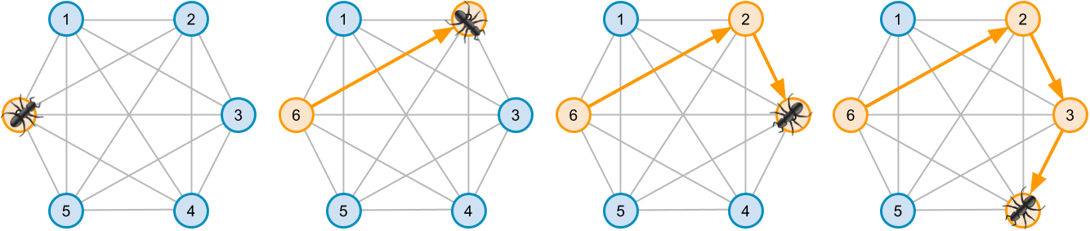
Ant Colony Optimization

Slide 14
Ant Colony Optimization
Ant population = 10
Ants choose next tasks to carry out among available tasks based on pheromone
Ants then choose which employees to assign to the task also based on a different pheromone
Employees are chosen so that the solution is valid : no overwork or missing skills

Slide 15
Ant Colony Optimization
Task pheromone:
Stores how likely a task-to-task edge is to occur
Employee pheromone:
Stores how likely an employee is to be assigned to a task
Pheromone is updated based on best solution among the ants

Slide 16
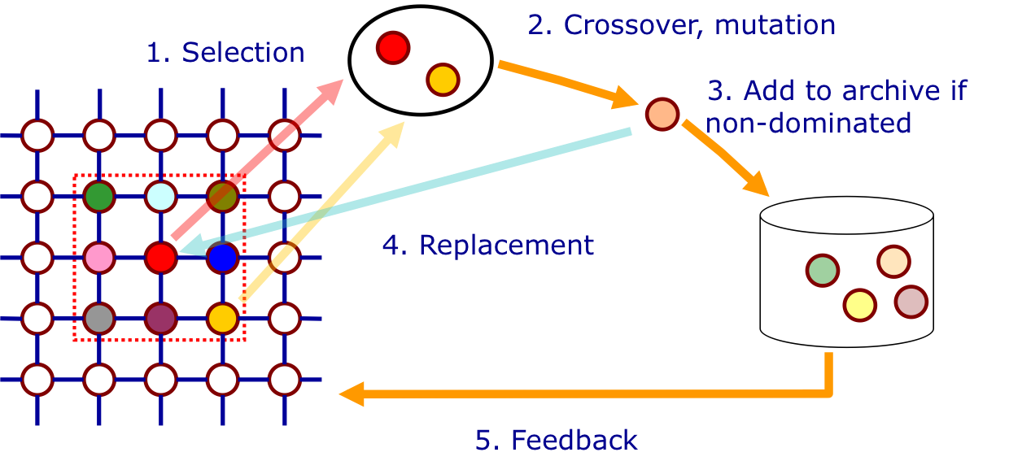
MOCell Implementation-summary

Slide 17

MOCell Implementation-gene
Employee 1
Employee E
Task1
X11 X12
.…
X1E
Xij :dedication of employee j in task i. in range of (0,1)
…
…
Task T
XT1 XT2
.…
XTE

Slide 18
MOCell parameters
Population size : 64
Neighborhood : 1-Hop neighbors(8 surrounding solutions)
Selection of parents : 2-member tournament
Recombination : 2-D SBX (Simulated Binary Crossover)
Mutation : Bit-Flip
Archive Size : 15

Slide 19
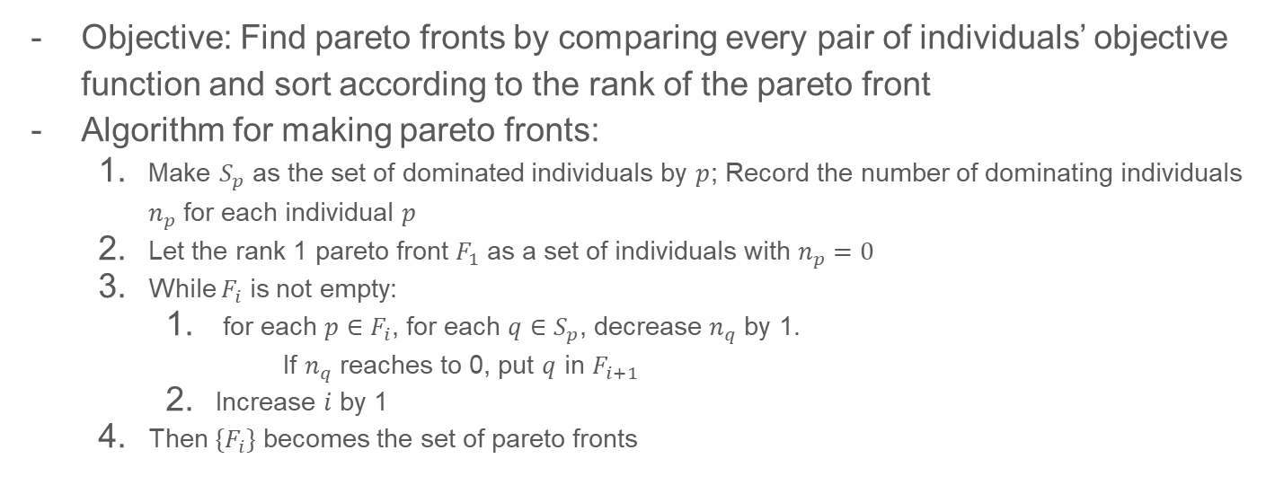
NSGA-II
Notes:
NSGA-II is the basic adaption of single-objective Genetic algorithm using non-dominated sorting.
It tries to find pareto fronts by comparing every pair of individuals’ objective function.
We first record the pareto front 1, and generate next pareto fronts by decreasing dominated number n_q.

Slide 20
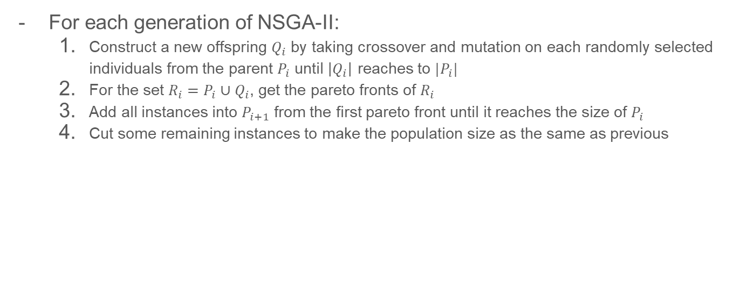
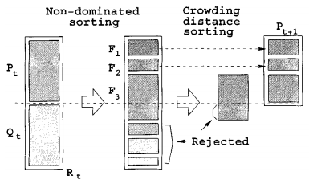
Main Loop of NSGA-II
Notes:
For each generation of NSGA-II, we made a child offspring from the current population with the same size. Then we sort the entire individuals by non-dominated sorting, and cut at the half to maintain the population size.

Slide 21
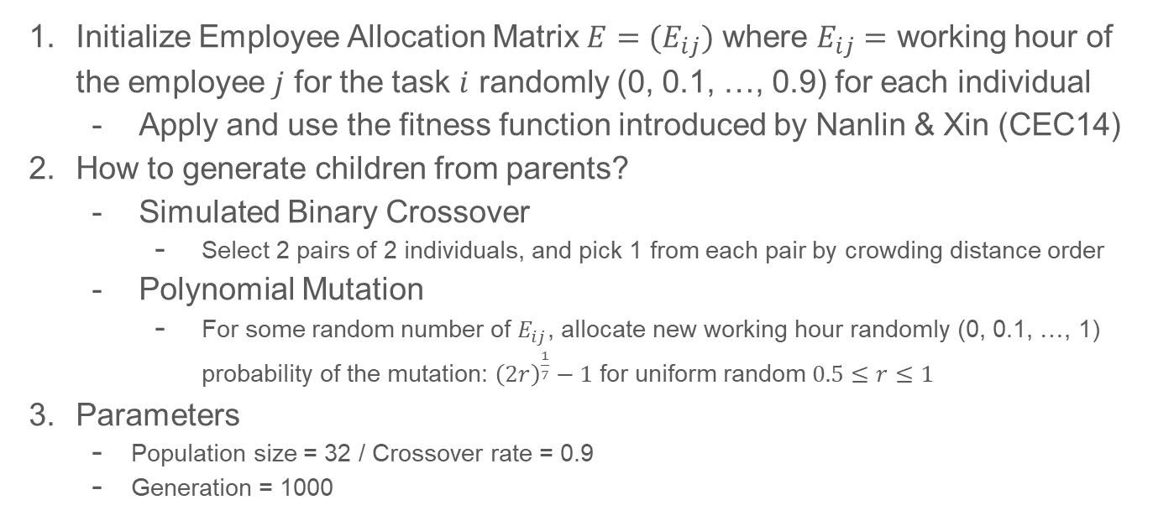
Adaptation to Solve Human Resource Allocation
Notes:
We first initialized the employee allocation matrix for each individual gene as the random number selected from 0 to 0.9. For each individual, we followed the same fitness function.
To generate the offspring, we used simulated binary crossover as crossover operator and polynomial-probability based mutation.
For simulated binary crossover, we first selected 2 pairs of 2 individuals and pick 1 from each pair by crowding distance order, and crossovered that 2 individuals.
For polynomial mutation, we selected each element in the employee allocation matrix by the probability of the proposed function. Then we allocated new random value for them.
We set the population size as 32, crossover rate as 0.9. And we made 1 thousand generation.

Slide 22
3. Results and Discussion

Slide 23
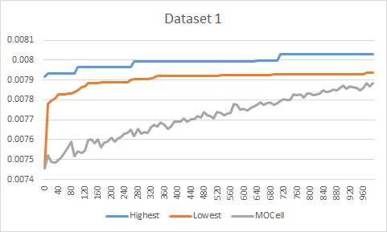
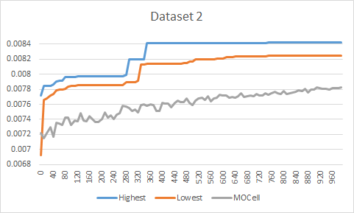
Comparison : NSGA II vs MO Cell
Notes:
Here is the comparison between NSGA2 and MOCell. In the big sight, you can see that the fitness value of both cannot exceed 0.01. It is because that these two GAs failed to get the valid instance from the initial invalid instances only with SBX and the mutation. In detail, You can see the main difference of the increasing phenomena between two algorithms. For each generation, MOCell archives the fitnesses by the comparison of two randomly selected individuals. Because of that, it starts from not the best value among the entire population, but gradually increases. NSGA2 has quite different phenomena. Since the next generation of NSGA2 is made from the sorted mixture of the current population and generated offspring, while the highest fitness value barely changes, the lowest fitness value changes more often.

Slide 24
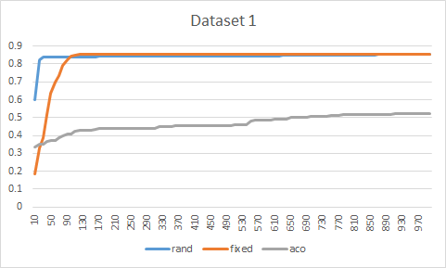
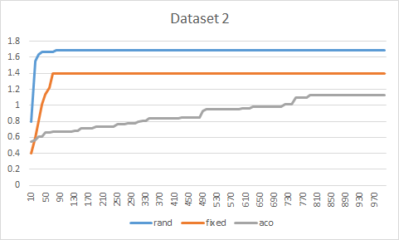
Comparison : Tabu vs ACO

Slide 25
Limitations and Future Works
Dataset limitations
No real data available
Try for larger dataset
2. Implementation accuracy
Further improvements, debugging to algorithms
3. Practicality of the solution
4. Scalability of team efficiency model

Slide 26
Q & A

